Slide 1
Syncplicity Introduction
Uli Hitzel
Principal Solutions Architect, Axway

Slide 2

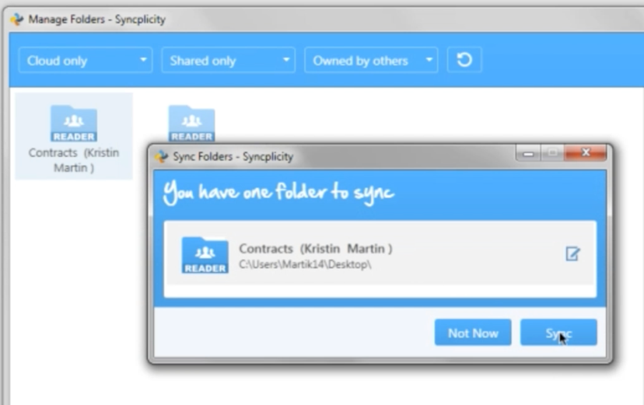

Syncplicity – Enterprise File Sync & Share Solution (EFSS)

Slide 3
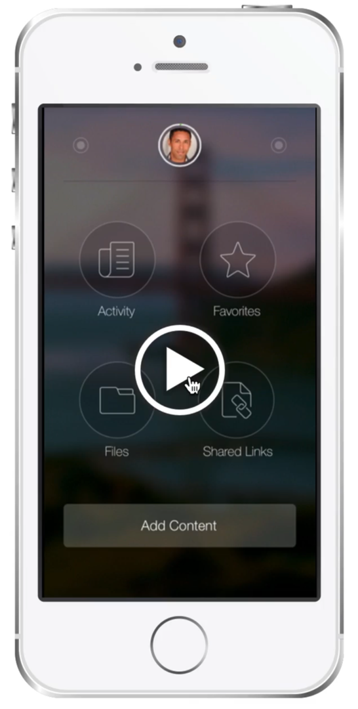
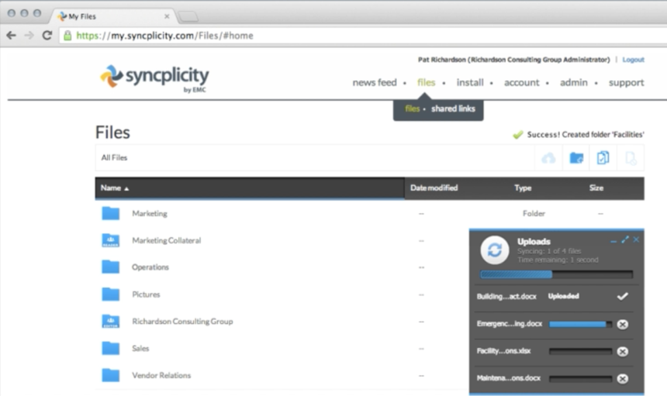
Syncplicity – Web & Mobile

Slide 4
Accelerating Digital Transformation by Modernizing IT and Empowering the Digital Workplace
Digital Workplace
Modernization of IT
Data Governance
Secure File & Folder Sharing
Multi-Folder Sync = Real-Time Backup
Access to all Files, Anytime, Anywhere – No VPN required
Mobile Enterprise
Collaboration & Office 365 Integrations
Connect to Content Systems Across the Enterprise
File Share Replacement
On-Premises, Private or Public Cloud (US & EU)
Accelerate & Automate the Migration of Unstructured Content
Replace Legacy Storage & Reduce Costs
Maximum Visibility & Control
Zero Content Knowledge
Data Sovereignty Options to Address Global Privacy Concerns
Complete Protection for Private Information

Slide 5

Digital Transformation at Siemens
SIEMENS AG
One of the world’s largest and most admired companies leading in industry, energy, healthcare and infrastructure
SIEMENS IT GOALS
SMARTSTORAGE SOLUTION
CUT COST
Expensive NAS infrastructure ($60M / year)
REDUCE IT ADMINSTRATION
NAS file share infrastructure outdated
Distributed over 200+ data centers
INCREASE USER PRODUCTIVITY
No offline access
No mobile access
Limited to no sharing and collaboration
COST SAVINGS
Annual savings of $24 Million
Migration from NAS to Elastic Cloud Storage
REDUCED IT ADMINSTRATION
Modern Syncplicity EFSS solution
Consolidated down to 4 global data centers
INCREASED USER PRODUCTIVITY
Mobile and offline access from anywhere
Easy and secure internal and external sharing and collaboration
Real-time desktop document protection and backup

Slide 6
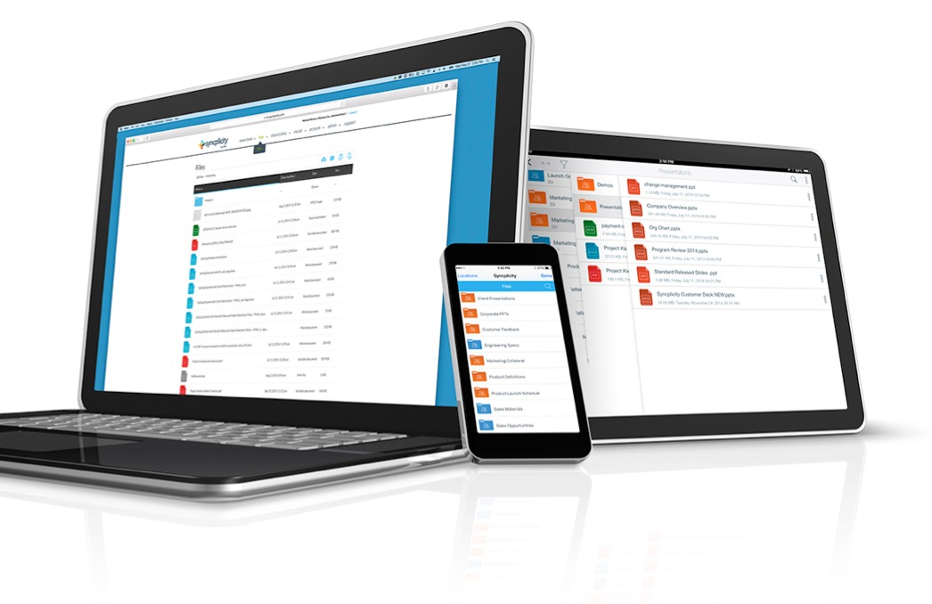
Key Features
Multi Folder Sync
In-Use File Notifications
Office365 Integration
Group Based Policies & PrivacyRegions
Hybrid Storage Choice

Slide 7
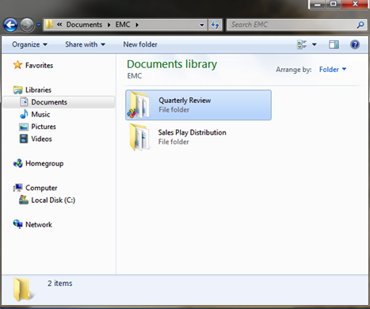
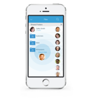


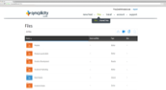


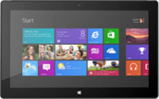
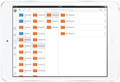


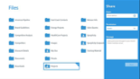
Save a file in any folder and it’s synced/accessible everywhere automatically
Push Sync w/Notifications
Automatic Upload/Download Resume
No File Size Limits
No Bandwidth Limits
Global De-Duplication
Automatic Version Control
Automatic Conflict Resolution
Multi-Folder Sync:
SYNC, SHARE & PROTECT WITH NO EXTRA STEPS
WINDOWS 8
IPHONE
ANDROID
MS SURFACE
MACBOOK AIR
IPAD
IPHONE
INSIDE FIREWALL
OUTSIDE FIREWALL

Slide 8
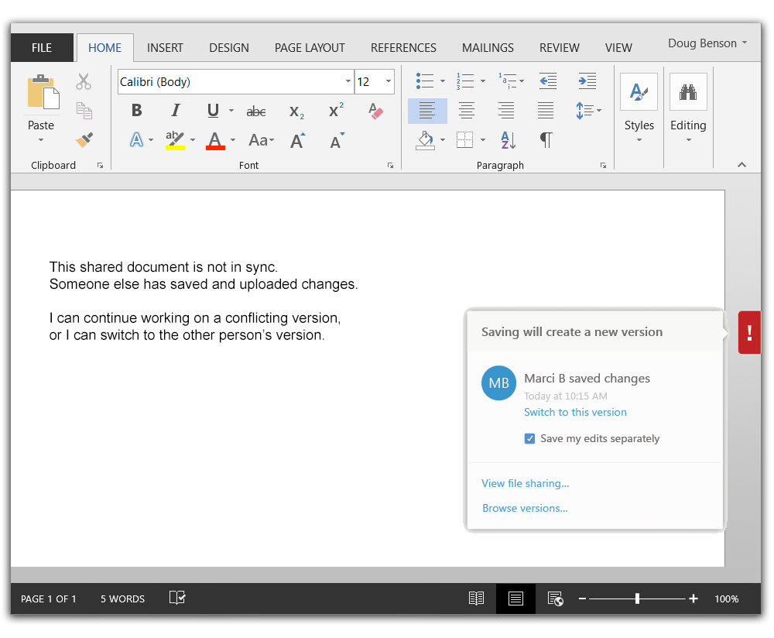
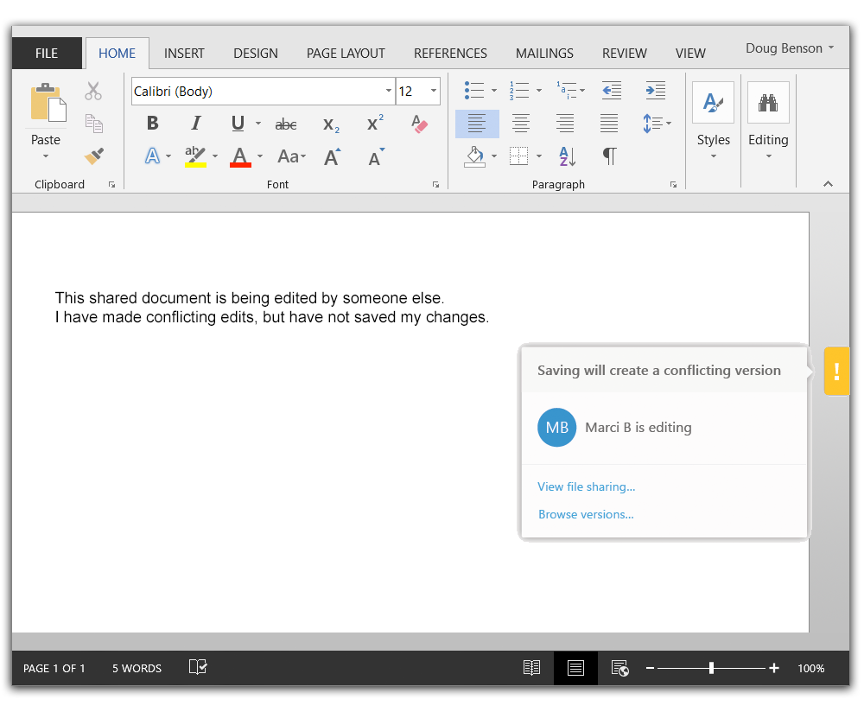
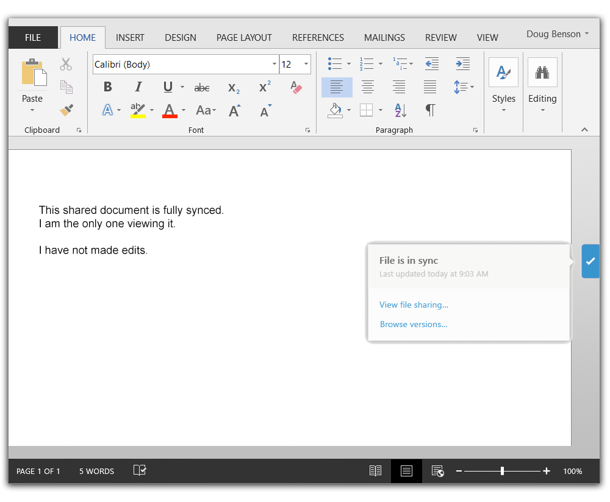
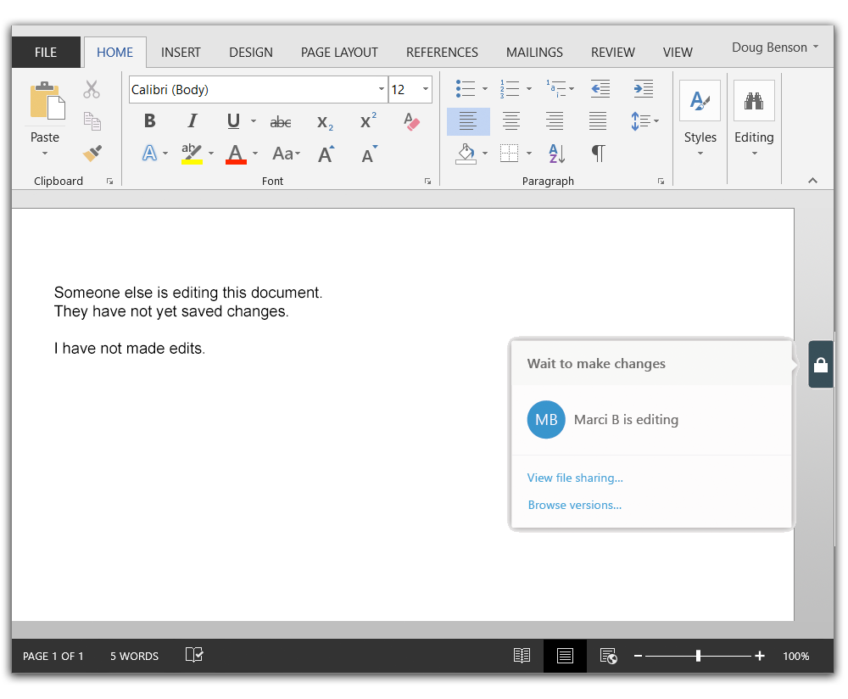
Collaboration:
Office App Tab
file in-use notifications
📂
Real-time visibility into other users’ activity in
Office documents
📂
Ability to switch to
other user’s version
📂
Enhances collaboration
and allows user to protect their edits

Slide 9
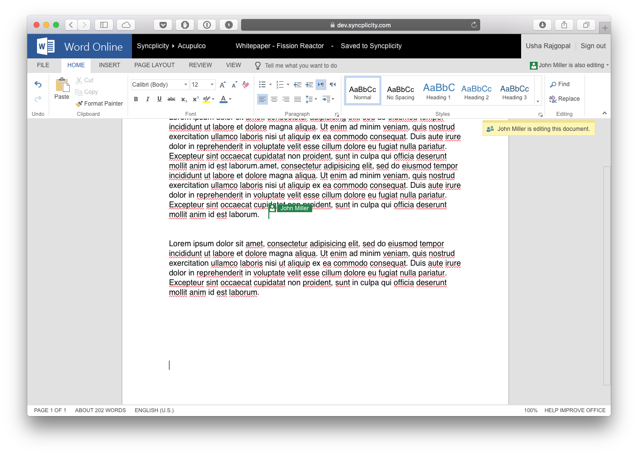
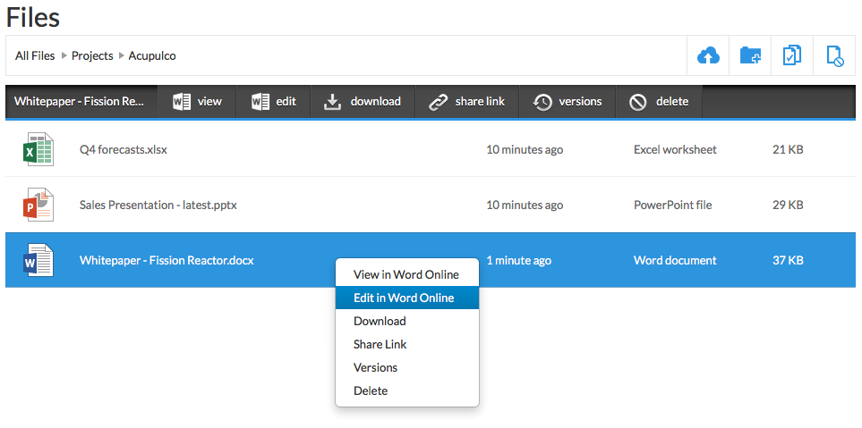
Collaboration: Office 365 Online Viewing & Editing
Online viewing and editing of Microsoft documents with Office 365 Online
Word, Excel, PowerPoint
Seamless integration into Syncplicity Online File Browser
Automatic save back to Syncplicity
Co-authoring in Office Online

Slide 10
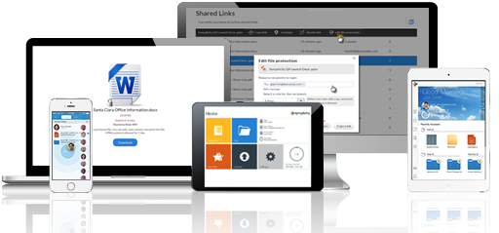











Syncplicity Security & Compliance
FRICTIONLESS USER EXPERIENCE
SECURITY
User | Device | Folder | File
Encryption, SSO, Remote Wipe, Retention, Reporting & Monitoring, Sharing/Access/Mobile Policies
ADMINISTRATION AND MANAGEMENT
User Management, Group Management, AD Sync
STORAGEVAULTS
Supported Storage Interfaces (NFS, S3, Atmos)
Syncplicity
Cloud
Service Provider
S3
NFS
OFF-PREMISE
ON-PREMISE

Slide 11

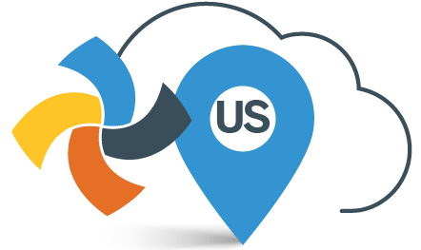
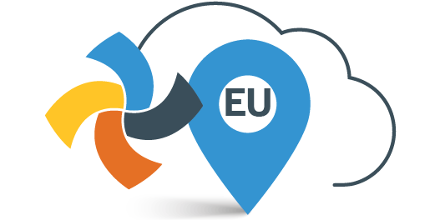


US & EU PrivacyRegions
Ensures meta-data is stored and processed exclusively in region of choice
Alleviates data transfer and data sovereignty issues
Seamless end-user experience across regions
Orchestrates automatic file transfer to meet compliance & residency requirements

Slide 12
Security Policies Overview
User
Protection
Device
Protection
Folder
Protection
File Protection
Monitoring and Reporting

Slide 13
Security Policies Overview
Internal sharing
External share
Access
Storage Quota
Internal sharing
External share
Access
Storage Quota
Internal sharing
External share
Access
Storage Quota
Internal sharing
External share
Access
Storage Quota
Marketing
Engineering
Finance/Legal
Default
Granular Group Based Policies
Be as permissive or restrictive as your organization requires

Slide 14


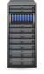




Syncplicity Enables Any Hybrid Architecture
INTERNET
CORPORATE NETWORK
MODE
U.S. HOSTED CLOUD
E.U. HOSTED CLOUD
VPCs (Virtual Private Azure Instance)
Storage Connector
CLOUD-BASED ORCHESTRATION
CLOUD-BASED ORCHESTRATION
AT&T Hosted
Storage Connector
U.S. HOSTED CLOUD
E.U. HOSTED CLOUD
AWS VPCs (Virtual Private Cloud)
S3 Bucket
Storage Connector
AWS VPCs (Virtual Private Cloud)
On Premise Private Cloud
Storage Connector
Syncplicity
Storage
Storage Connector
Syncplicity
Storage
EMC
NAS
3rd Party
NAS
Storage Connector
EMC
ECS / ATMOS

